Slide 1
COMP 3311 Database Management Systems Fall 2024
Lab 8. A brief introduction to the ODBC interface

Slide 2
Objectives of the Lab
You know how to connect to CSE Oracle database server using your SQL Developer client.
This lab studies how to connect the server with another client, the ODBC interface:
After this lab, you will learn the following:
Connect to CSE Oracle database server through the ODBC interface using the C++ running on Visual Studio (VS).
Issue SQL queries in the C++ executable using the ODBC interface.

Slide 3
Brief introduction to ODBC 1
ODBC stands for Open DataBase Connectivity.
It provides a standardized database interface that is independent of the DBMS being accessed.
It also supports high-level programming languages such as C, C++, C#, VB, PHP etc…

Slide 4
Brief introduction to ODBC 2
Key components of the ODBC interface :
Driver manager: to load the proper DBMS driver on behalf of an application (i.e. a C++ program in our case).
Driver: to process the ODBC function calls and submit SQL requests to the specified data source
Data sources: referring to the database objects in the connected DBMS via your account (i.e. Oracle DBMS server in our case)

Slide 5
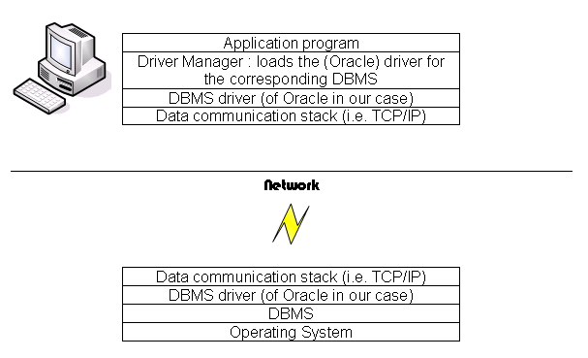
Brief introduction to ODBC 3
A simplified ODBC Architecture:

Slide 6
This Lab
In this lab, you will learn how to interact with the OBDC environment with visual studio
Set up OBDC environment for visual studio
Build the SQL database
Perform queries from a program generated in visual studio IDE:
Connect to the database via your Oracle account
Execute the SQL queries embedded in the program

Slide 7
This Lab
In this lab, you will learn how to interact with the OBDC environment with visual studio
Set up OBDC environment for visual studio
Build the SQL database
Perform queries in visual studio
Connect to the data sources
Execute the submitted queries

Slide 8
Set up OBDC environment for visual studio
You must set up the ODBC data source before running your program
On your own window machine
On the lab machine using your CSE account
This designates the driver for VS to connect with a DBMS
We first show the installation (i) on your window machine and then (ii) the lab machine

Slide 9
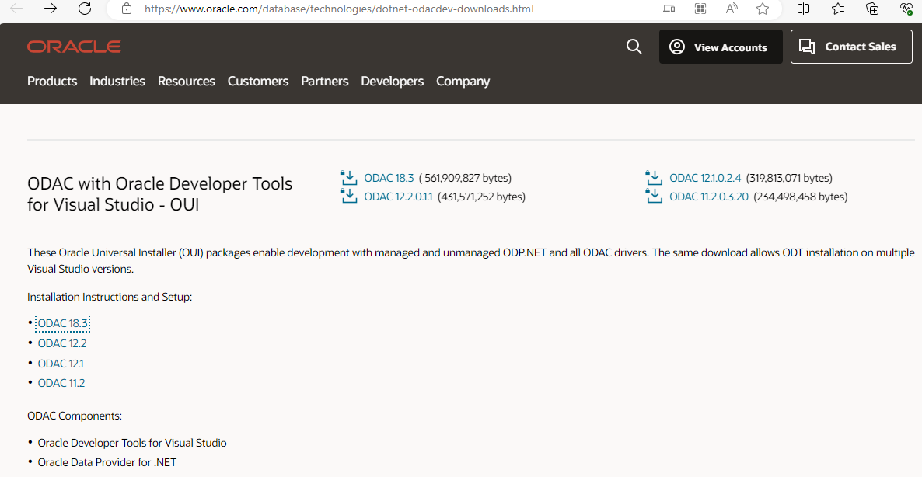
(i) Download ODBC interface on your window machine:
Go to: http://www.oracle.com/technetwork/topics/dotnet/utilsoft-086879.html
For ODAC 18.3, go to: https://www.oracle.com/database/technologies/dotnet-odacdev-downloads.html
Click ODAC 18.3

Slide 10
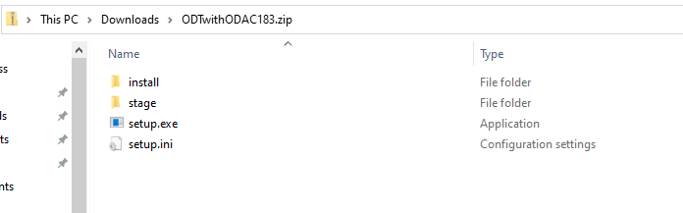
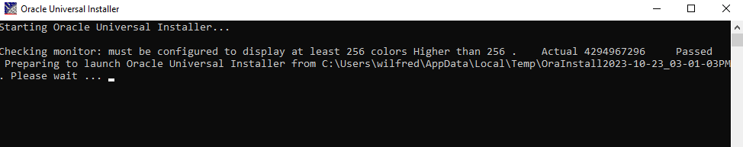
Run the setup file:
Run setup.exe in the folder “ODTwithODAC32” or directly from the downloaded zip file

Slide 11
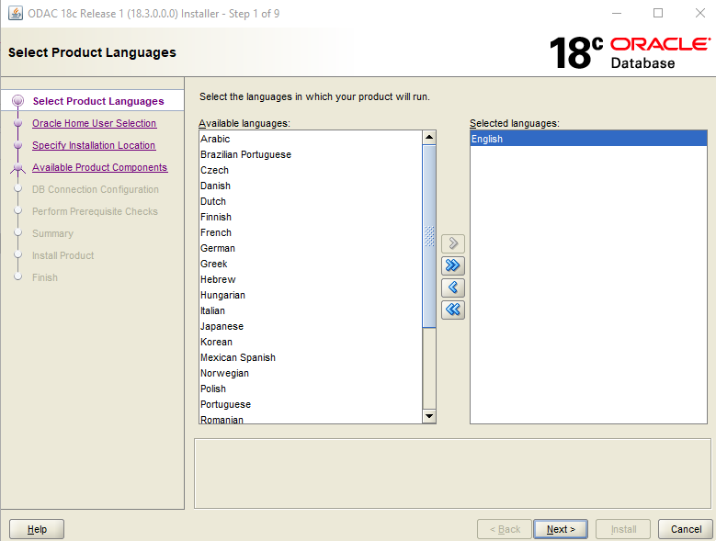
Fill the information in the installer – Step 1 Choose language

Slide 12
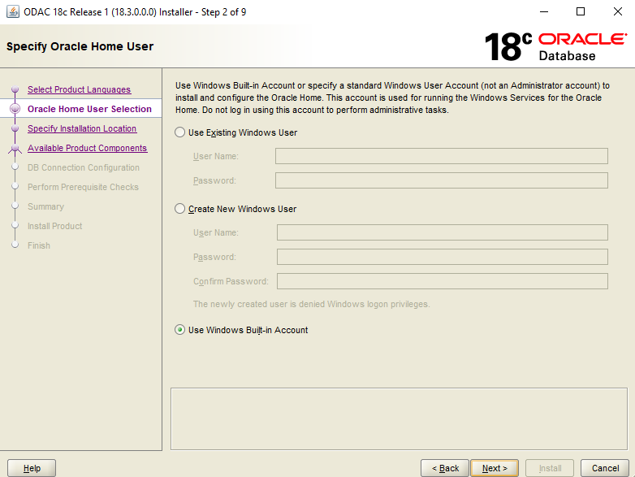
Fill the information in the installer – Step 2 Specify User - Use Windows Build in Account

Slide 13
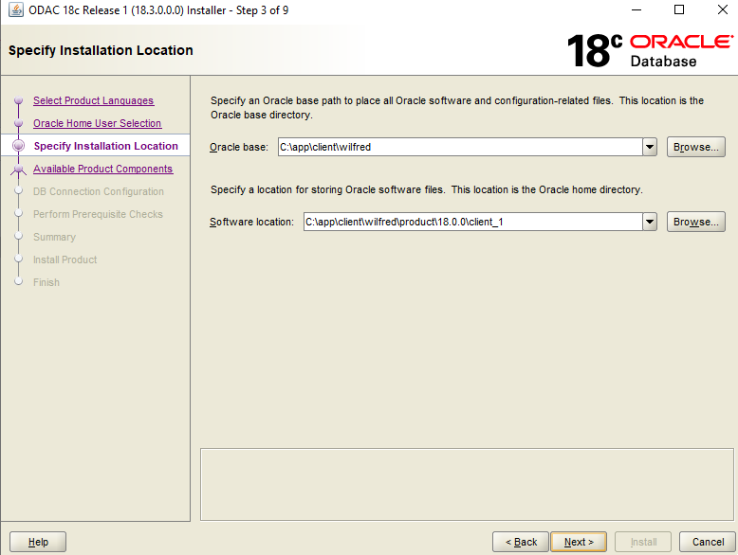
Fill the information in the installer – Step 3 - Remember the path of the installation location

Slide 14
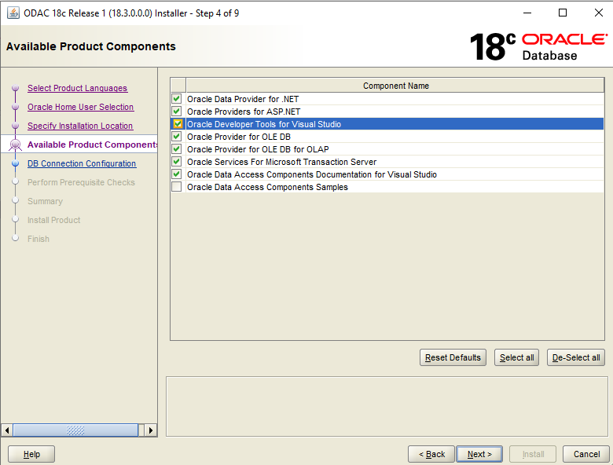
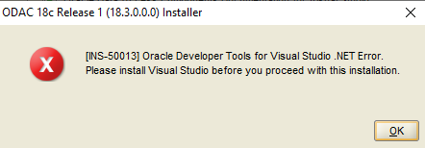
Fill the information in the installer – Step 4 – Choose available product components
There may be an error as follows:
If it happens you should uncheck the box to continue (next)

Slide 15
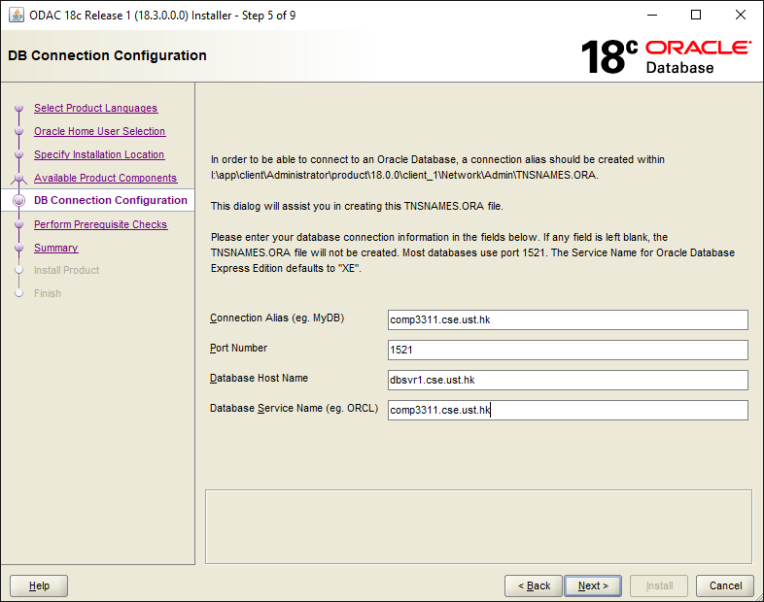
Set TNSNAME
Port Number: 1521
Database host name: dbsvr1.cse.ust.hk
Database Service Name: comp3311.cse.ust.hk
Type in the TNSNAMES file should be: dedicated
(use the given file tnsnames.ora in the directory)

Slide 16
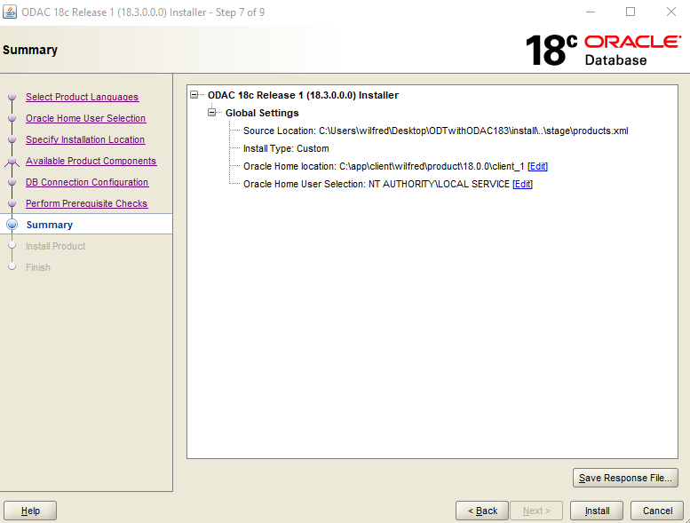
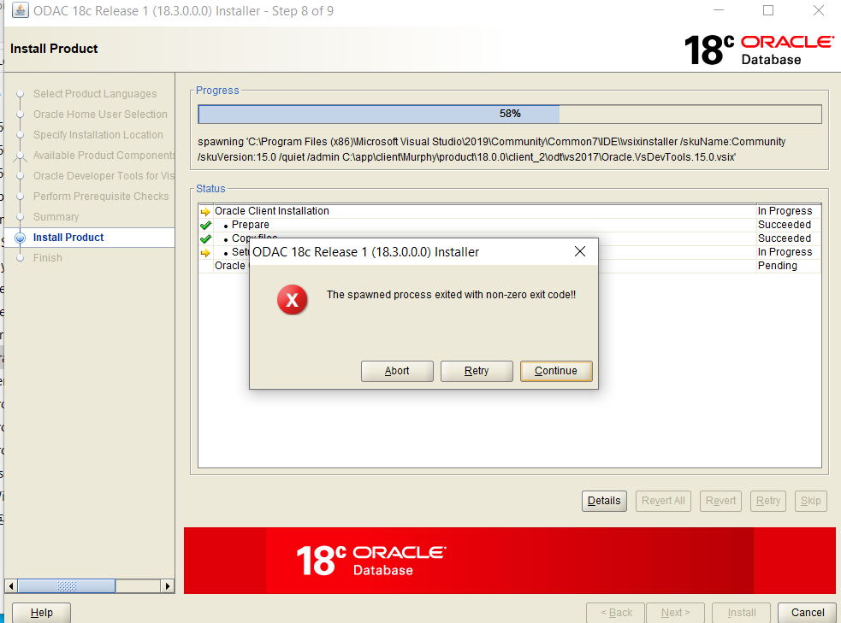
Click install to set the driver
No worry about the warnings during the process. For example if you met something like this, click continue

Slide 17
Installing No worry about the warning below
If you met this, click continue

Slide 18
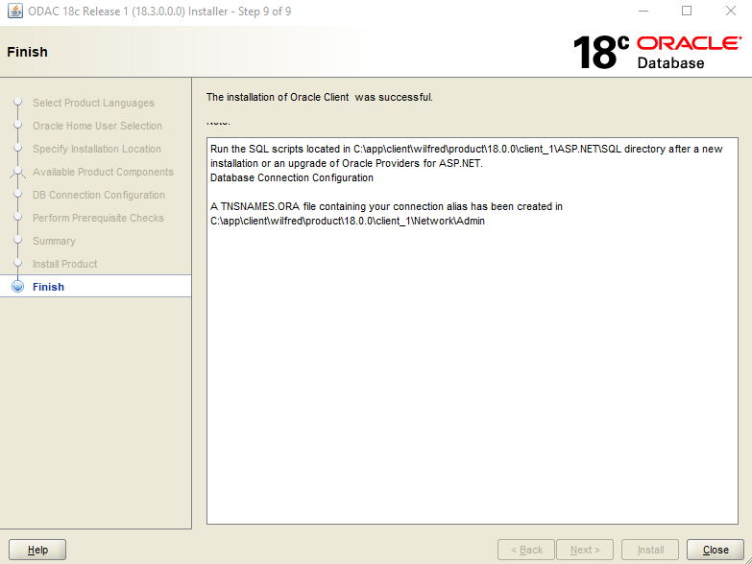
Finish
If the database connection cannot be established later (see slide 30), try to replace the TNSNAMES.ORA file here with our given one.

Slide 19
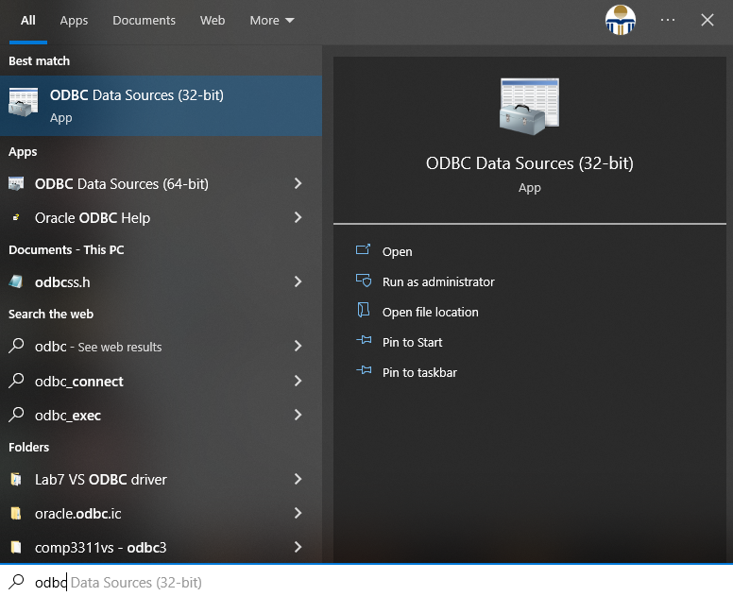
Search ODBC

Slide 20
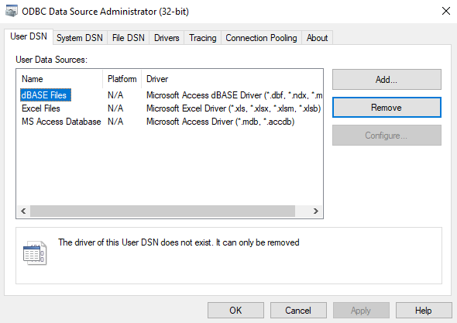
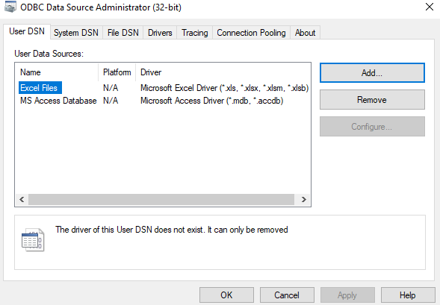
Remove dBASE and Add ODBC driver

Slide 21
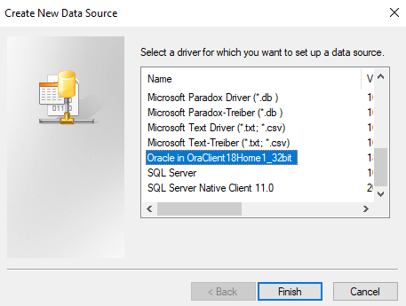
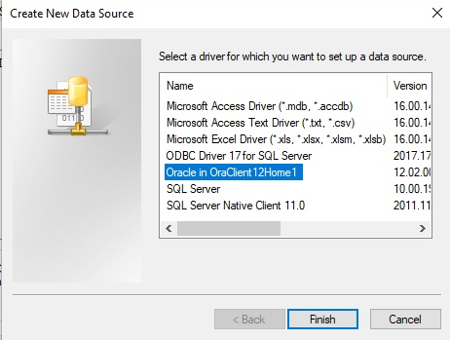
Select Oracle OraClient18Home
Note: For the lab machine, you should choose the following driver

Slide 22
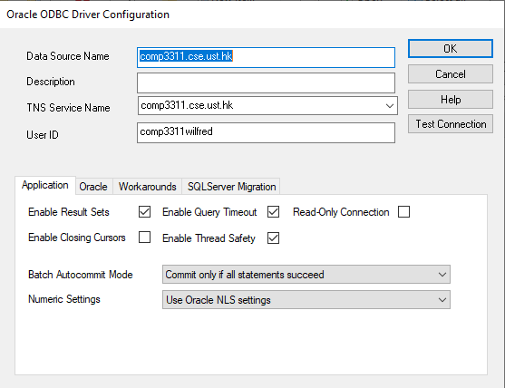
Set the configuration and Test

Slide 23
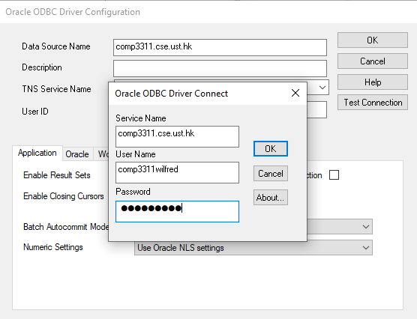

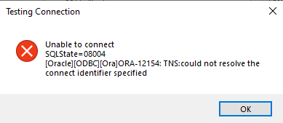

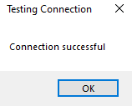
Test Oracle Connection and successful:
Don't forget to connect to HKUST VPN if you are not in UST
Fill in your Oracle account details

Slide 24
(ii) Steps to set up ODBC environment using the lab machine 1
In the CSE Lab, we have already installed the ODBC driver at:
c:\windows\syswow32\odbcad32.exe
You can download and install the Oracle ODBC driver on your own machine from:
Additional Oracle .NET and Visual Studio ODAC Downloads
Choose ODAC 18.3

Slide 25
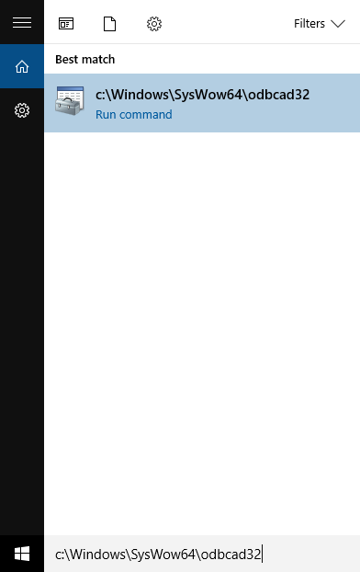
Steps to set up ODBC environment using the lab machine 2
1. You can setup the Oracle ODBC source in MS windows (the most important steps!)
Click the “start” button , then key in “c:\Windows\system32\odbcad32.exe”

Slide 26
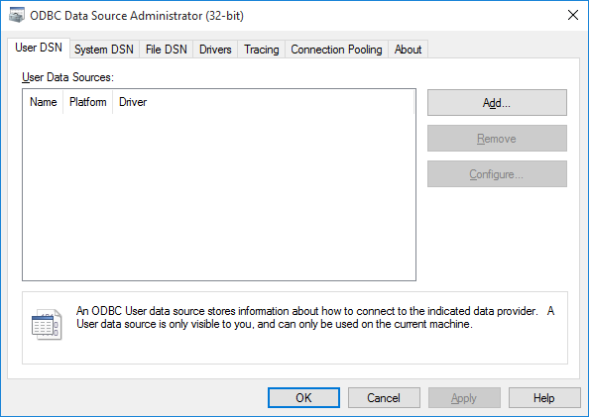
Steps to set up ODBC environment using the lab machine 3
2. You should see the below window and click the “Add” button

Slide 27
Steps to set up ODBC environment using the lab machine 4
3. Add the Oracle data source and click “Finish”.

Slide 28
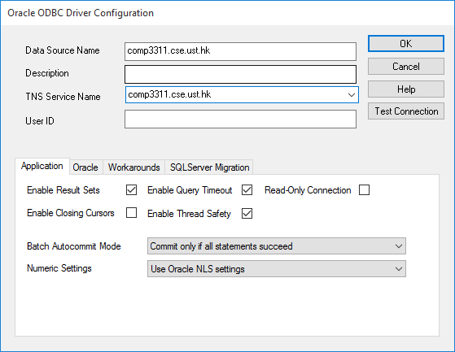
Steps to set up ODBC environment using the lab machine 5
4. Give a name to the Data Source (you need this name in the SQLConnect() function for running the program, the name here is “comp3311.cse.ust.hk”)

Slide 29
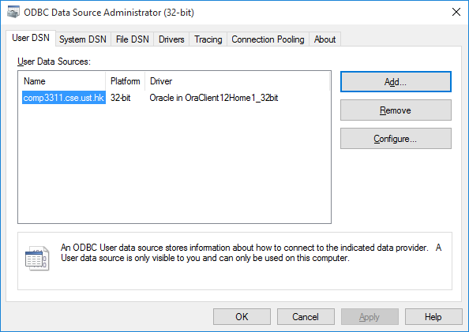
Steps to set up ODBC environment using the lab machine 6
5. The name “comp3311.cse.ust.hk” appears in the data source administrator window. You are now ready to write ODBC codes.

Slide 30
Steps to set up ODBC environment using the lab machine 7
(Optional) Only laptops connected to the UST network can access the CSE Oracle server. To enable setting up the data-source you should download following two files to the laptop:
http://course.cse.ust.hk/comp3311/labs/sqlnet.ora
http://course.cse.ust.hk/comp3311/labs/tnsnames.ora
(Optional) Store the two files to the default Oracle_path that you selected for installing the ODBC driver (for example, C:\app\client\wilfred\product\18.0.0\client_1\Network\Admin).

Slide 31
This Lab
In this lab, you will learn how to interact with the OBDC environment with visual studio
Set up OBDC environment for visual studio
Build the database using Oracle SQL Developer
Perform queries in visual studio
Connect to the data sources
Execute the submitted queries

Slide 32
Building the SQL database 1
For this lab, we initialize the database for future queries with lab8.sql (downloaded from Lab page)
We run lab8.sql in SQL developer and commit the database so that the ODBC is able to interact with the two tables: departments, students

Slide 33
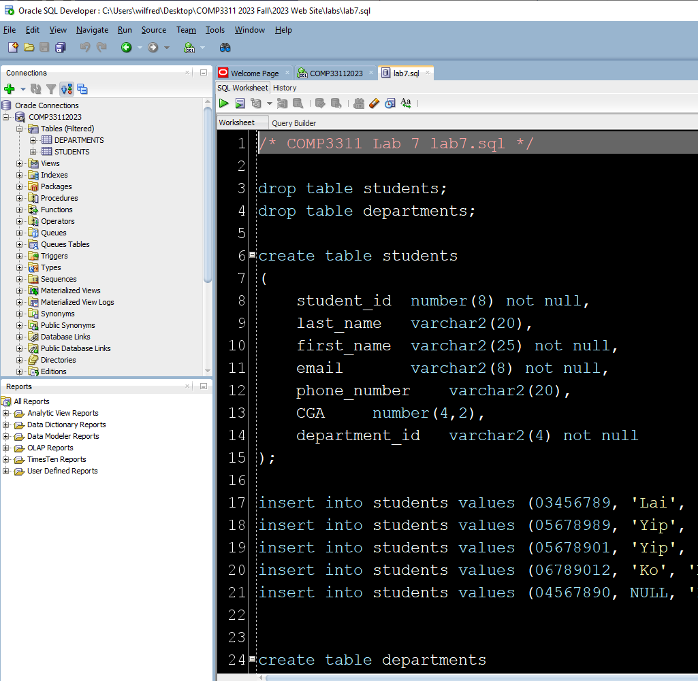
Building the SQL database 2
Run lab8.sql in SQL Developer to create two tables:

Slide 34
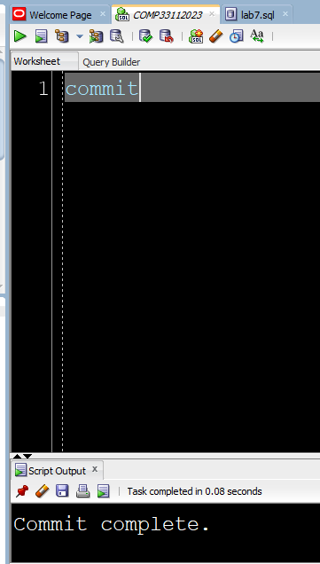
Building the SQL database 3
Commit the changes to the database by running commit command
Check from the script output that the commit was successful

Slide 35
This Lab
In this lab, you will learn how to interact with the OBDC environment with visual studio
Set up OBDC environment for visual studio
Build the SQL database
Perform queries in visual studio
Connect to data source
Perform queries

Slide 36
Perform queries in visual studio
Now that the ODBC environment and the database has been set up, we can use visual studio to perform embedded queries in C++ code
This code serves two purposes:
Connect to the data source
Perform the queries

Slide 37
This Lab
In this lab, you will learn how to interact with the OBDC environment with visual studio
Set up OBDC environment for visual studio
Build the SQL database
Perform queries in visual studio
Connect to data source
Perform queries

Slide 38
Connecting to a data source 1
To connect to the Oracle server through the ODBC interface, one needs to:
Include the proper headers (<sql.h>, <sqlext.h>) to the C++ program,
Initialize ODBC environment,
Allocate a connection handle,
Connect to the data source which corresponds to the Oracle server.

Slide 39
Connecting to a data source 1
Include the proper headers (<sql.h>, <sqlext.h>) to the C++ program
#include "stdafx.h"
#include <windows.h>
#include <sql.h>
#include <sqlext.h>
#include <sqltypes.h>

Slide 40
Connecting to a data source 2
To initialize ODBC environment, one needs to
Declare a variable of the type HENV,
Call the SQLAllocEnv() function and pass it the address of the variable:
HENV henv;
/* Allocate environment handle */
SQLAllocEnv( &henv);

Slide 41
Connecting to a data source 3
To allocate a connection handle one needs to
Declare a variable of the type HDBC
Call the SQLAllocConnect() function and pass it the address of the variable. The ODBC driver would allocate memory for storing the connection information:
HDBC hdbc;
/* Allocate connection handle */
SQLAllocConnect(henv, &hdbc);

Slide 42
Connecting to a data source 4
To connect to the Oracle data source, one needs to call the SQLConnect() function and provide it with:
Data source name (in our case comp3311.cse.ust.hk)
Oracle account (your comp3311stuxxx account)
Oracle account password (your password)
SQLConnectA(hdbc, (SQLCHAR*) "comp3311.cse.ust.hk", SQL_NTS, (SQLCHAR*) "comp3311stu120", SQL_NTS, (SQLCHAR*) “123456", SQL_NTS);
“comp3311.cse.ust.hk” is the data source name
“comp3311stu120” is an Oracle account name
“123456” is the password of the account
SQLCHAR is a char type of SQL
SQL_NTS denotes that the previous argument in the function is a Null Terminated String

Slide 43
This Lab
In this lab, you will learn how to interact with the OBDC environment with visual studio
Set up OBDC environment for visual studio
Build the SQL database
Perform queries in visual studio
Connect to data source
Perform queries

Slide 44
Performing Query 1
To perform the SQL operations using the ODBC interface, you need to:
Allocate a statement handle
Submit an SQL statement for execution
Retrieve the results

Slide 45
Performing Query 2
To allocate a statement handle, you need to:
Declare a variable of the type HSTMT,
Call SQLAllocStmt() function and pass the connection handle (hdbc) and the address of the HSTMT-typed variable.
HSTMT hstmt;
/*allocate the statement handle*/
SQLAllocStmt(hdbc, &hstmt);

Slide 46
Performing Query 3
To submit an SQL statement for direct execution (prepared statement will be covered next time), you need to:
Call SQLExecDirect() function and pass it with the SQL statement as well as the statement handle (hstmt)
SQLExecDirectA(hstmt, (SQLCHAR *) “SELECT department_ID FROM departments",SQL_NTS);

Slide 47
Performing Query 4
To retrieve the results you need to:
Bind variables to the attributes of the query results using SQLBindCol() function:
/* bind the char string variable "deptid" to get the result (column 1) from the query*/
SQLBindCol(hstmt,1,SQL_C_CHAR,deptid,50,&deptid_n);
column value target type
target variable
target buffer length
string length of the returned data

Slide 48
Performing Query 5
Fetch the results using the SQLFetch() function:
/* fetch the results into the variable "deptid" and then display*/
while (TRUE){
retcode=SQLFetch(hstmt);
if (retcode==SQL_SUCCESS || retcode \
==SQL_SUCCESS_WITH_INFO)
{printf("%s\n",deptid);}
else break;
}

Slide 49
Terminating the program
To gracefully terminate, you need to
Disconnect from the Oracle data source
Free the environment variable and the handle:
The complete code for connecting to the Oracle server of COMP3311 is available at the Lab Page:
http://course.cse.ust.hk/comp3311/labs/odbc1.cpp
If you are using room 4210 computers, please use this file due to ODAC version issue (ODAC 12.2 is installed in 4210 computers):
http://course.cse.ust.hk/comp3311/labs/comp3311.cpp
SQLFreeStmt(hstmt,SQL_CLOSE);
SQLDisconnect(hdbc);
SQLFreeConnect(hdbc);
SQLFreeEnv(henv);

Slide 50
Putting everything together (odbc1.cpp) 1
#include <iostream>
#include <sql.h>
#include <sqlext.h>
#include <sqltypes.h>
int main(int argc, char* argv[]) {
HENV henv;
HDBC hdbc;
HSTMT hstmt;
RETCODE retcode;
SQLINTEGER sqlcode,deptid_n;
SQLSMALLINT len;
SQLCHAR deptid[50];
/* Allocate environment handle */
retcode = SQLAllocEnv( &henv);
/* Allocate connection handle */
retcode = SQLAllocConnect(henv, &hdbc);
/* Connect to the service */
retcode = SQLConnectA(hdbc, (SQLCHAR*) "comp3311.cse.ust.hk", SQL_NTS, (SQLCHAR*) "comp3311stu120", SQL_NTS, (SQLCHAR*) “123456", SQL_NTS);
if (retcode == SQL_SUCCESS || retcode == SQL_SUCCESS_WITH_INFO){
printf ("Connected to Oracle.\n");}
Replace with your Oracle account ID and password

Slide 51
Putting everything together (odbc1.cpp) 2
/* execute a SELECT statement*/
SQLAllocStmt(hdbc, &hstmt);
SQLExecDirectA(hstmt, (SQLCHAR *) "select department_ID from departments",SQL_NTS);
/* bind the char string variable "deptid" to get the result from the query*/
SQLBindCol(hstmt,1,SQL_C_CHAR,deptid,50,&deptid_n);
/* fetch the results into the variable "deptid" and the display*/
while (TRUE){
retcode=SQLFetch(hstmt);
if (retcode==SQL_SUCCESS || retcode ==SQL_SUCCESS_WITH_INFO)
{printf("department_id = %s\n",deptid);}
else break;
}
/* free resources */
SQLFreeStmt(hstmt,SQL_CLOSE);
SQLDisconnect(hdbc);
SQLFreeConnect(hdbc);
SQLFreeEnv(henv);
return 0;
}

Slide 52
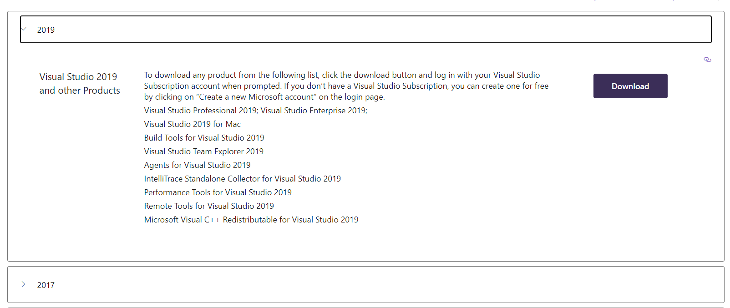
Install Visual Studio 2019
The official site for VS 2019
https://visualstudio.microsoft.com/vs/older-downloads/
Choose 2019. Note that ODBC may not work for other VS version

Slide 53
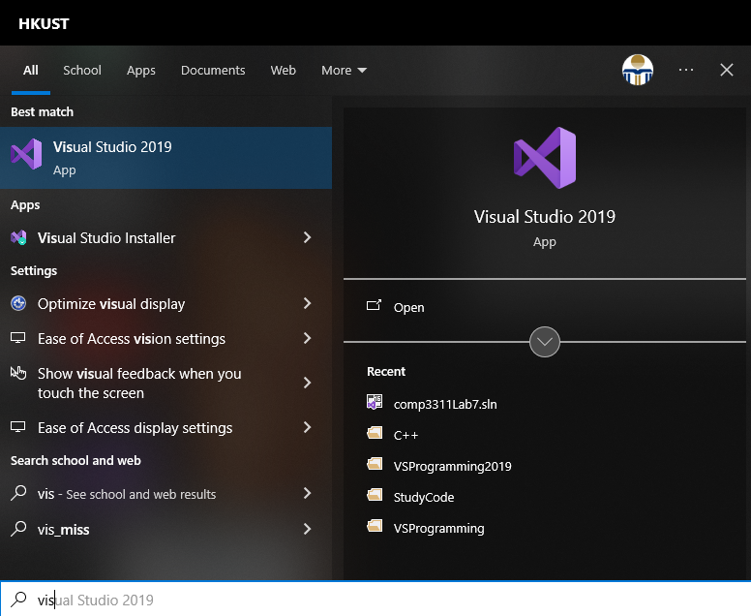
Working with Visual Studio 2019 1
To start Visual Studio, one need to locate the visual studio 2019 package.
Search “Visual Studio 2019”.
Click on the VS icon as shown to start.

Slide 54
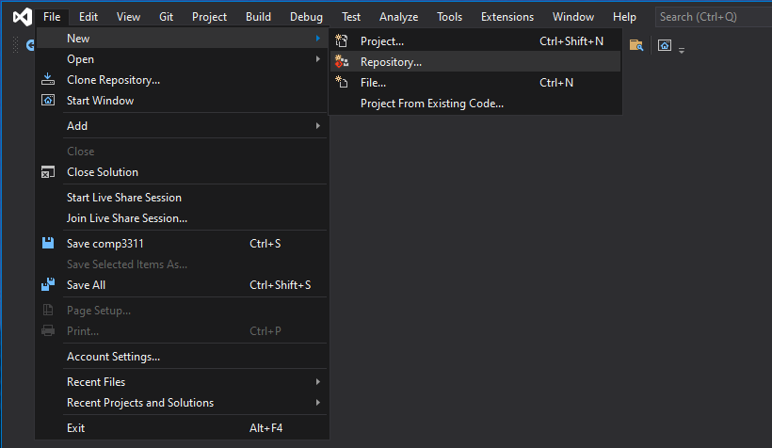
Working with Visual Studio 2019 2
Select “File->New-> Project…” from the toolbar

Slide 55
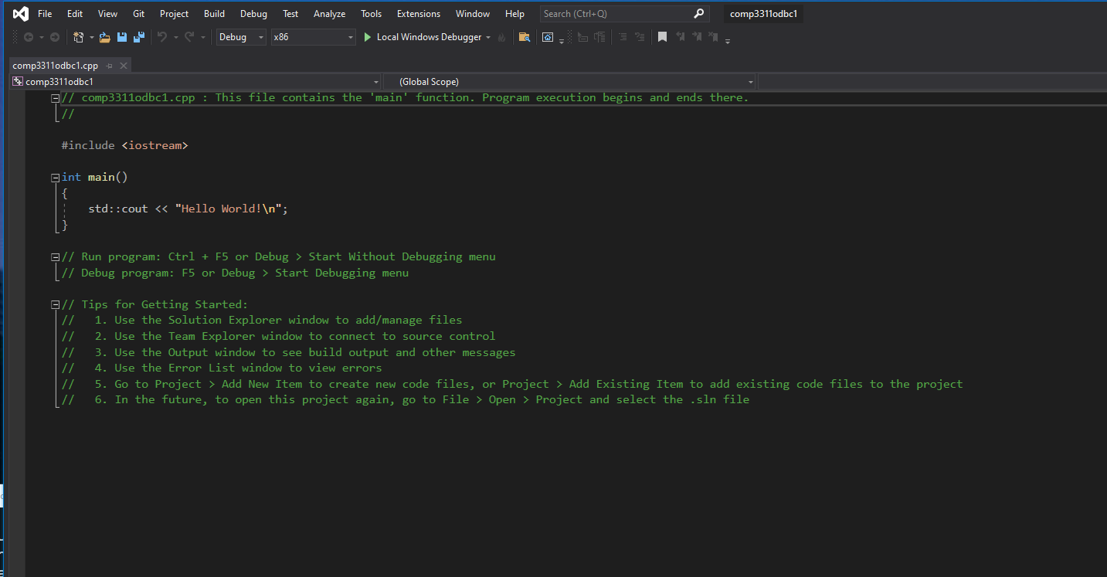
Working with Visual Studio 2019 4
Then click “next” and “finish”, and you will see the following template (a hello world c++ program):

Slide 56
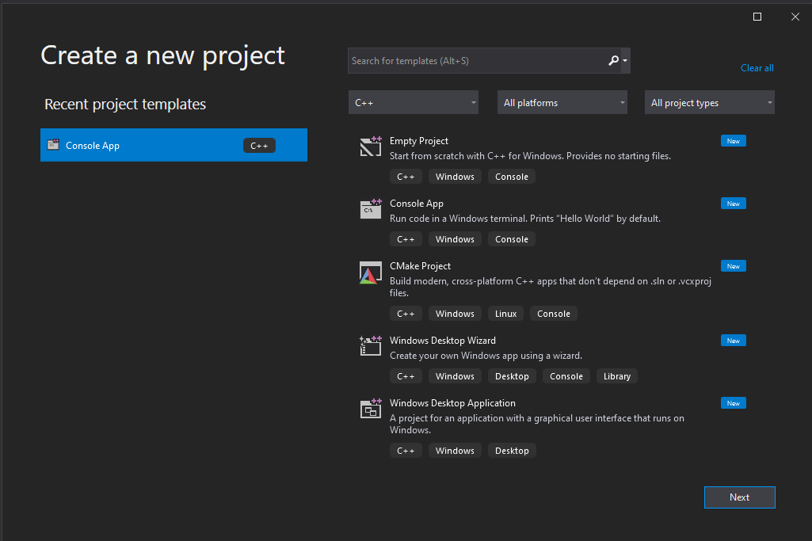
Working with Visual Studio 2019 3
Select “Win32 Console Application”, and give the C++ project a name.

Slide 57
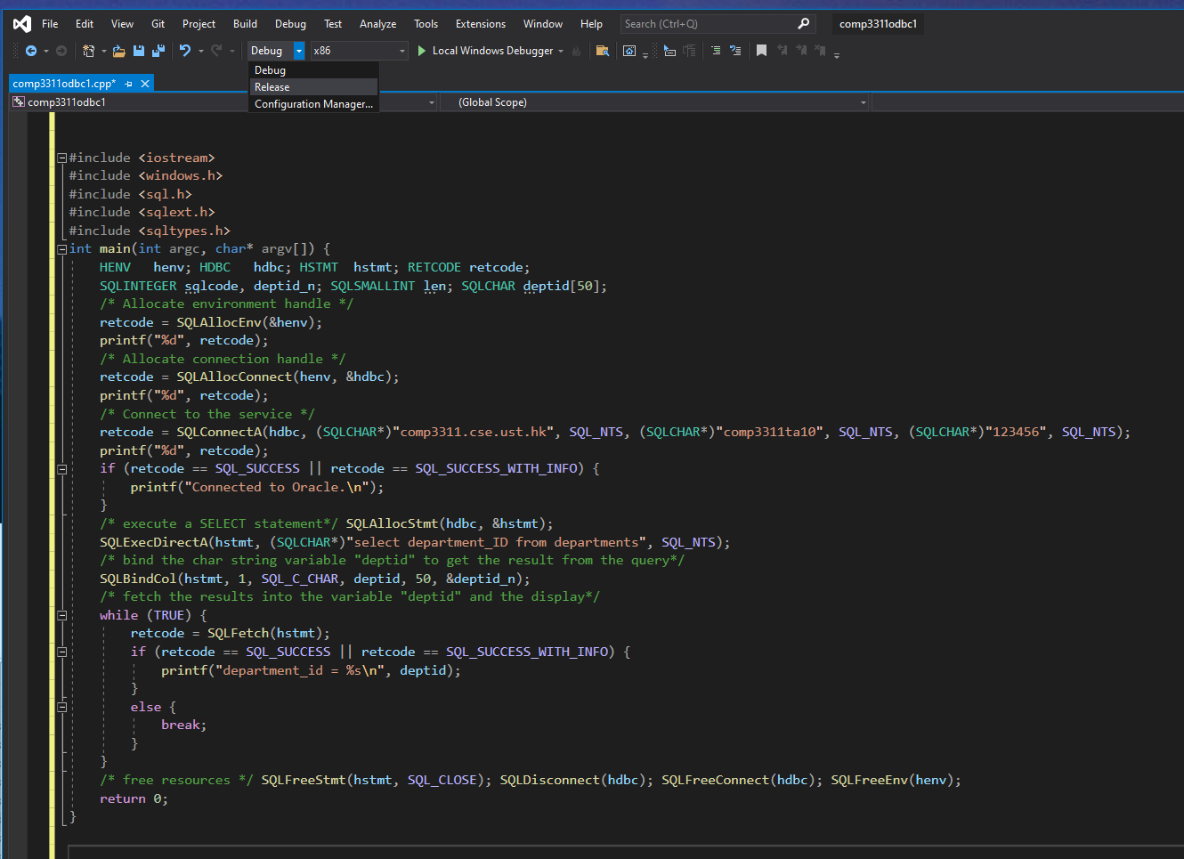
Working with Visual Studio 2019 5
Replace the C-codes with odbc1.cpp you have downloaded, and select “Release” for the compilation option.

Slide 58
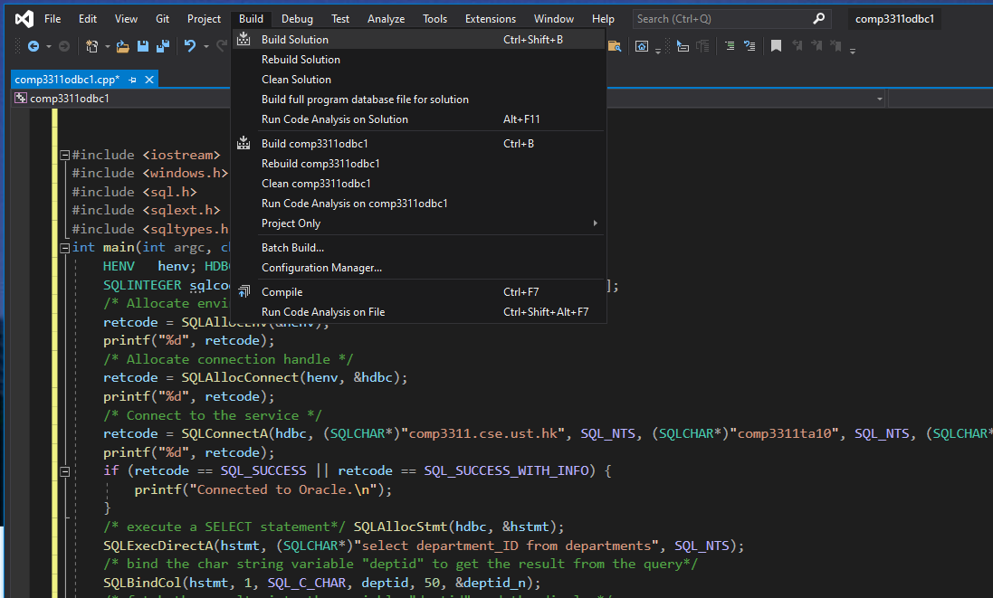
Working with Visual Studio 2019 6
Save the file and compile the program by selecting “Build Solution”.

Slide 59
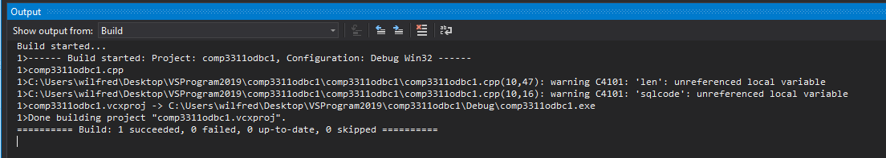
Working with Visual Studio 2019 7
Open a Windows command window (type “cmd” at “run…”)
Change to the directory where the executable is located:
Then run the executable from the path.
Note that the connection to the Oracle server is successful, and results are returned.
Here the path is the location of the executable code of the program

Slide 60
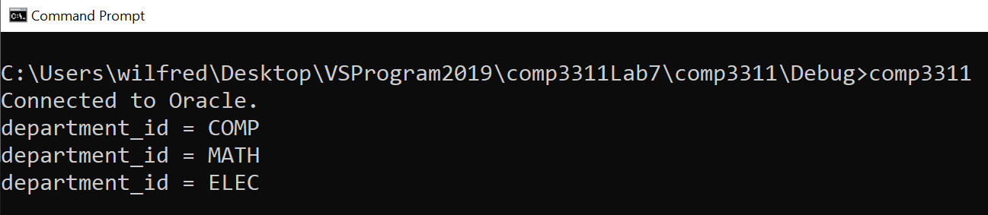
The result
Compile and run the program
If the connection to the Oracle server is successful, results are returned as follows.

Slide 61
Conclusions
We covered the following topics in this lab:
Connect to the Oracle server of COMP3311 through the ODBC interface
Issue simple SQL queries using the ODBC interface

Slide 62
Summary of the installations and tasks
Oracle SQL Developer (may need to register)
Using lab8.sql to create the database (students and departments tables)
Visual Studios 2019
Download and install: Visual Studios 2019
Create a new project folder
Choose/install C++ template
Launch (copy) odbc1.cpp, save (release) and compile (build) in the project folder (using your own Oracle account in odbc1.cpp (You should use comp3311.cpp instead of odbc1.cpp if you use a lab machine))
ODBC (may need to register an account for installing on a personal machine)
Download and install: ODAC18.3 (In lab, the machine has the ODBC executables)
Configure ODBC Data Sources (32 bit). Test the connection with your Oracle account, note the use of tnsnames.ora file in the setting if failed.
Finally, run the c++ executable in command prompt to check the output result as Slide 60

